Slide 1
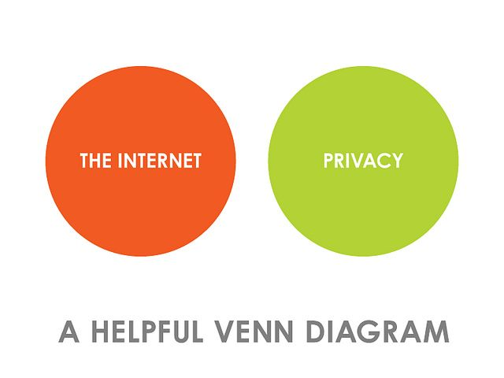
INFO215: Week 7a
Information Privacy & Social Technology Systems, pt. 1
https://theappslab.com/2010/10/22/privacy-and-the-internet/

Slide 2
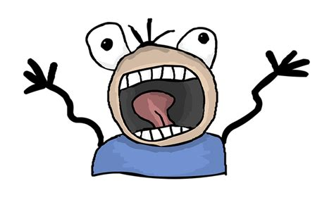
FOR THURSDAY
REMINDER: Your utopia/dystopia op-ed (Assignment 2) is due on Thursday!
Any questions about your project?

Slide 3
Poll – Question #1
In general, I consider myself to be:
Very private
Middling private
A little private
Not private at all

Slide 4
Poll – Question #2
In general, I am:
Very hesitant to share personal information online
Somewhat hesitant to share personal information online
Fairly willing to share personal information online
Very willing to share personal information online

Slide 5
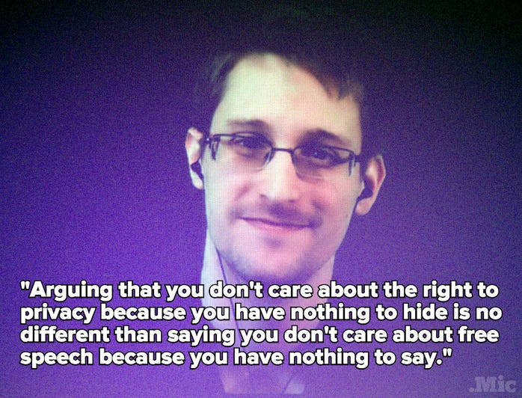
Quote by Edward Snowden. Photo from: https://www.mic.com/articles/119602/in-one-quote-edward-snowden-summed-up-why-our-privacy-is-worth-fighting-for.

Slide 6
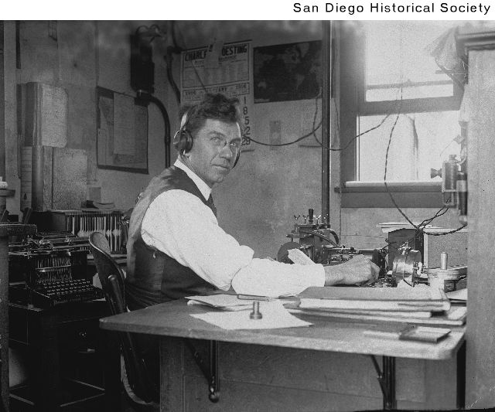
Privacy and information systems is not a new issue! Early telegraph users (as early as the 1840’s) worried about operators listening in on their conversations.

Slide 7
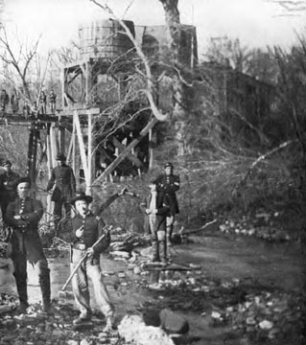
Wire tapping
Civil War combatants cut telegraph lines, tapped lines, and added false reports (1860’s).
http://www.pimall.com/nais/pivintage/telegraph.html

Slide 8
Privacy & Technology
Information technologies connect but also identify you.
No networked information system is completely private. If you can access it, then someone else can, too.
Think for a minute:
What personal data have you already given away today?
So far this week? Ever?

Slide 9
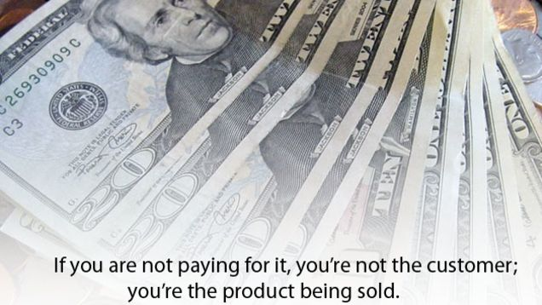
Privacy & Technology
Think again: What have you traded your personal data for so far today? So far this week? Ever?
What’s your reaction to this quote?

Slide 10

Privacy & Information Systems
Differences between public and private life.
Embedded in social values—varies by culture.
Mentioned not in the U.S. Constitution, but addressed in the Bill of Rights. It is increasingly being battled out in the courts via case law.

Slide 11
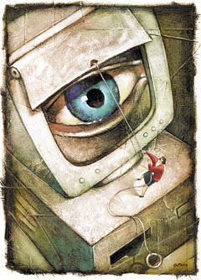
Public/Private
Security, privacy and trust are flipside concerns of increased connectivity.
When we place private information in the public domain, it is public.
But what is “private”?
http://www.parcbench.com/2010/04/18/yahoo-defies-court-order-defends-internet-privacy/

Slide 12
What is “privacy,” anyway?
No exact definition; Westin (1967) = most common definition; says that privacy involves the ability to control the terms under which personal information is acquired and used
In social media/social computing, “privacy” is tied to having control over the types of personal information made available online and having control over who can access it (Livingstone, 2008; Mallan, 2009).

Slide 13
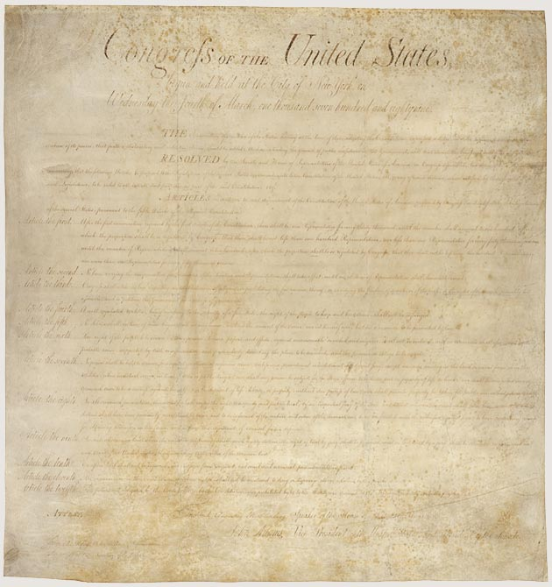
Privacy is not specifically mentioned in the Constitution, but in the Bill of Rights.
The Bill of Rights, Fourth Amendment, guarantees “[t]he right of the people to be secure in their persons, houses, papers, and effects, against unreasonable searches and seizures” – a right to privacy.
http://www.archives.gov/exhibits/charters/

Slide 14
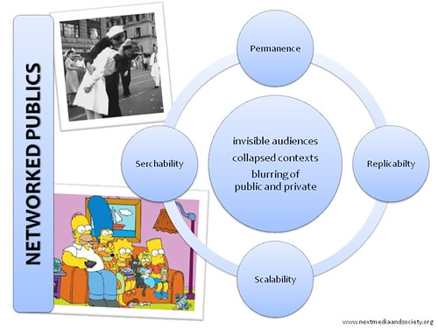
Public/Private
Again, it’s important to understand that no exact definition of “privacy” exists.
Definitions of privacy previously attached to home and personal property, fixed and specific, have started to become attached to individual as they move through society.
People are now moving through society electronically and expectations are changing.
SNS as “networked publics” (boyd, 2007)
boyd, d. (2008) Why youth (heart) social network sites: The role of networked publics in teenage social life. In Youth, Identity, and Digital Media (119–42). Cambridge, MA: MIT Press.

Slide 15
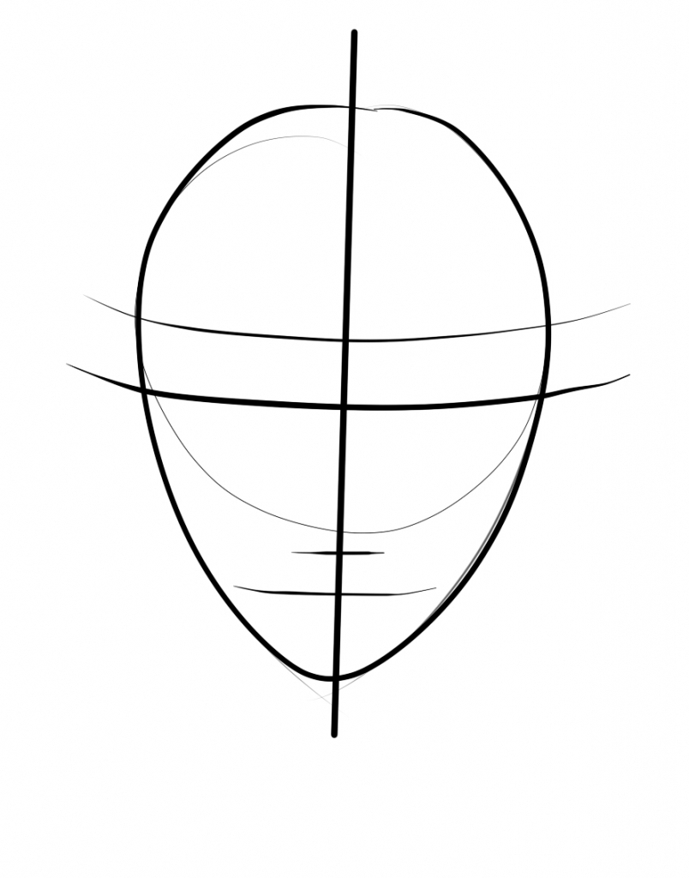
Who has your face?
Take the quiz: https://whohasyourface.org/

Slide 16
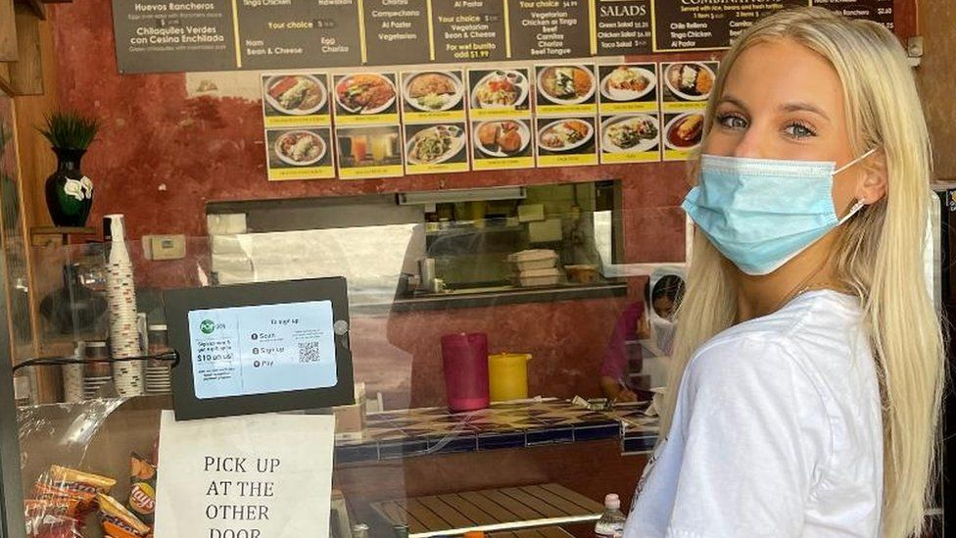
BBC News, January 21, 2021, “Why your face could be set to replace your bank card,” https://www.bbc.com/news/business-55748964
Video version: https://www.youtube.com/watch?v=J7xwbRE81sw
Would you use your face as your bank card? Why or why not?

Slide 17
Mozur & Krolik, “China’s Vast, Unstoppable Effort to Spy on Its 1.4 Billion People”
Uses phone scanners, facial-recognition cameras, face and fingerprint databases and more
An estimated 600 million Chinese surveillance cameras were in place by the end of 2020.
“The United States and other countries use some of the same techniques to track terrorists or drug lords. Chinese cities want to use them to track everybody.” (Mozur & Krolik)
Saves data on largely unprotected servers
Matches people’s faces to their phone numbers
Private contractors and middlemen have access to citizens’ personal data
Some citizens worry that extra COVID measures will become permanent
How China’s Mass Surveillance Works, February 9, 2021

Slide 18
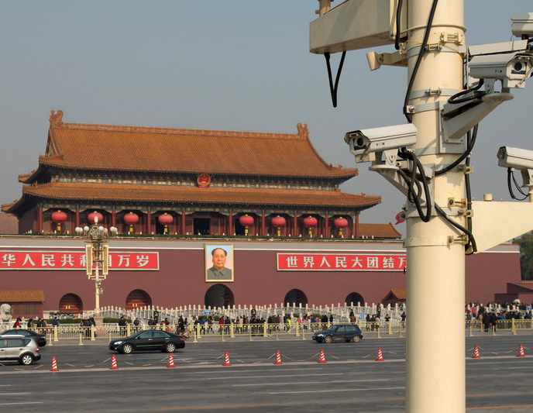
Chinese Tech Surveillance: Where Do You Stand?
1. Do you think the Chinese government has the right to gather surveillance data on its citizens when they are in public spaces? When they are in private spaces?
2. Do you think other countries will soon follow the Chinese public surveillance model? Why or why not?

Slide 19
How do contextual factors affect people’s information sharing?
Lessig (1998) talks about four regulators of human behavior. How do each of these four factors regulate what people share via social media?
Market
Social Norms
Laws/Rules
Architecture/Code
Lessig, L. (1998). The new Chicago school. The Journal of Legal Studies, 27(S2), 661-691.

Slide 20
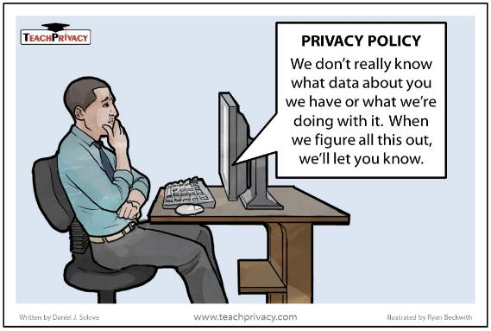
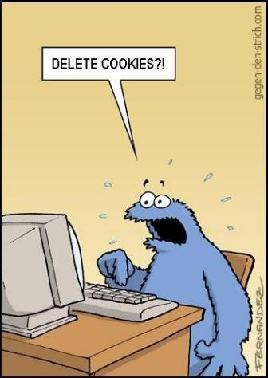
Information Privacy and the Sociotechnical Perspective

Slide 21
Privacy, Security, and Design
Web 2.0 and 3.0 support configurable privacy settings.
Let users choose the level of privacy settings they are comfortable with because privacy is not “one-size fits all.”
This increases the complexity of designing user-friendly privacy policies.
And, many – even most – users use default privacy and security settings. Why do you think this is so?

Slide 22
Discussion Questions
How can we design technologies to support user variance in desire to share personal information?
How do we reconcile users’ and institutions’ (corporations, government agencies, academic institutions, etc.) different privacy-related interests?

